Slide 1
Rockbuster Stealth LLC
Database Analysis
Presented by Sue Dow

Slide 2
Project Overview
Rockbuster Stealth LLC
Movie rental company looking to launch online video rental service
Competition: Netflix, Amazon Prime & other online streaming services
Objective
Analyze Rockbuster Stealth data to answer key questions and drive organizational strategies for 2020

Slide 3
Key Questions
Movie Revenue
Which movies contributed to the most/least revenue gain?
Rental Durations
What was the average rental duration for all videos?
Global Market
Which countries are Rockbuster customers based in?
High Value Customers
Where are the customers with a high lifetime value based?
Sales
Do sales figures vary between geographic regions?

Slide 4

Rental Overview
1,000 films
599 Customers
$2.98 Average Rental Payment
5 days Average Rental Duration
Ranges 3-7 days

Slide 5
Movie Revenue
Over $200
Less than $6
Top Movie Rental Revenue Least Movie Rental Revenue

Slide 6
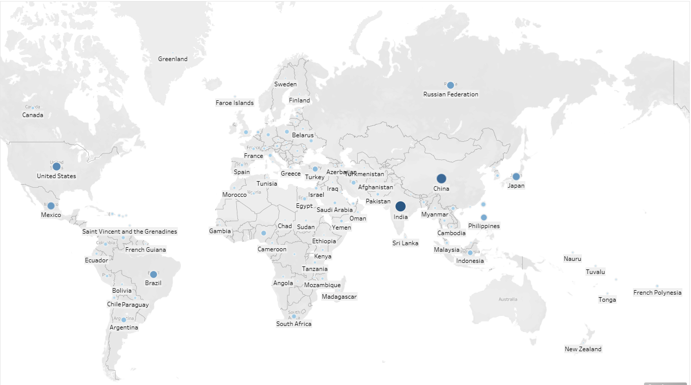
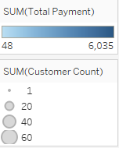
Global Market
Customers in 108 countries
Netherlands
Top five overall customers in
Reunion
US
Brazil
Netherlands
Belarus
Reunion

Slide 7

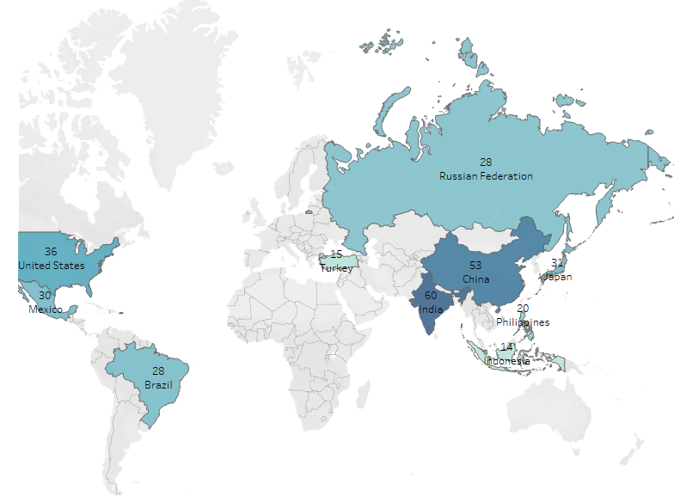
Global Market
Customers in 108 countries
Top 10 countries

Slide 8
Trends
Top Film Categories by Revenue
Top Film Categories by Rental Orders

Slide 9
Trends
Top 5 Film Rentals by Revenue
Bottom 5 Film Rentals by Revenue

Slide 10

Conclusions
Most popular type of movie are sports movies
Top countries for movie rentals are India, China, US
High value customers are located across the globe

Slide 11
Recommendations
Consider trending movie types to countries
Consider focusing on Comedy films as they are the in the top five rentals along
Consider trending age groups

Slide 12
Questions?
Thank you!

